Slide 1


Note: The data and information in this document is reflective of a hypothetical situation and client. This document is to be used for KPMG Virtual Internship purposes only.
Sprocket Central Pvt Ltd
Data analytics approach
Nayan Srivastava

Slide 2
Note: The data and information in this document is reflective of a hypothetical situation and client. This document is to be used for KPMG Virtual Internship purposes only.
Introduction
Customers analysis :
Age Clusters distributions
Customer RFM value distributions
Number of bike purchases in 3 years / percentages purchases
Job industry category.
Wealth segments
Number of cars own on each states
Gender Distributions

Slide 3
Note: The data and information in this document is reflective of a hypothetical situation and client. This document is to be used for KPMG Virtual Internship purposes only.
Introduction
Steps followed for customer analysis :
Constructed columns for age and profit in Customer Demographics and Transactions respectively.
Merged the worksheets using primary keys,lookup functions and Power Query.
Conducted a RFM (Recency, Frequency and Monetary) analysis.
Created column for recency.
Created Pivot tables for RFM analysis.
Customer Profile and RFM value Visualisation.
Created Pivot tables for Age clusters and Profitability.
Created Pivot tables for cars owned in different states.
Created Pivot tables for bike related purchases and Industry.
Created Pivot tables for Profit and Industry .

Slide 4
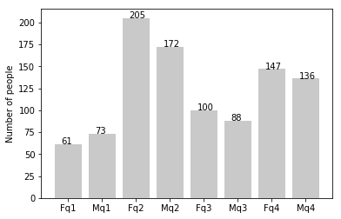
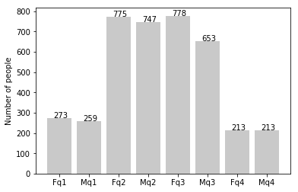
Note: The data and information in this document is reflective of a hypothetical situation and client. This document is to be used for KPMG Virtual Internship purposes only.
Data Exploration
new
Customers’ age distribution
As we can see, mostly our new customers are between 25 to 48 years old.
Number of customers from 48 to 59 years old has big drops on percentages.
There is a slightly increase in number of customers over 59 years old in term of percentages
It looks like the percentages of under 25 years old not really change.
Fq- Female , Mq- Male
1 – age < 25 years
2 – 25 to 48 years
3 – 48 to 59 years
4- > 59 years
old

Slide 5
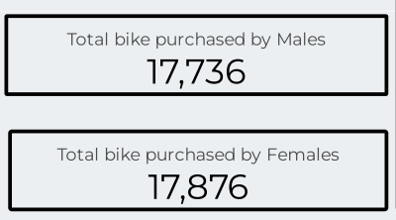
Note: The data and information in this document is reflective of a hypothetical situation and client. This document is to be used for KPMG Virtual Internship purposes only.
Model Development
Bike purchases last 3 years
As we can see, our new customers mostly Female with 50.2% purchases with total of 17,876 bikes
Male contributed to 49.8% purchases with 17,736 bikes
So, we can focus equally on both the genders.

Slide 6
Note: The data and information in this document is reflective of a hypothetical situation and client. This document is to be used for KPMG Virtual Internship purposes only.
Interpretation
Job industry category
Mostly our customers are on Finance Services,Health and Manufacturing Industries.
Profit is also the highest from the above mentioned job categories.
We have good number of new customers in these three categories so, we should target more on them.

Slide 7
Note: The data and information in this document is reflective of a hypothetical situation and client. This document is to be used for KPMG Virtual Internship purposes only.
Interpretation
Numbers of cars owned :
New South Wales should be considered the most, since numbers of customers owned cars is highest there.
Also the number of customers not owning cars are highest in New South Wales Only .So, we have huge target audience there.

Slide 8
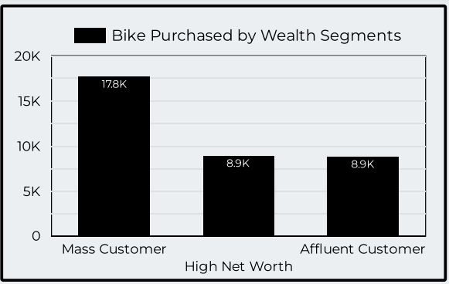
Note: The data and information in this document is reflective of a hypothetical situation and client. This document is to be used for KPMG Virtual Internship purposes only.
Interpretation
Wealth Segment :
Among all the segments , Mass Customers segment has the highest customers.
Also we have high number of new customers in Mass Customers segment, so this can be the target wealth segment for our products.

Slide 9
Note: The data and information in this document is reflective of a hypothetical situation and client. This document is to be used for KPMG Virtual Internship purposes only.
Interpretation
Profit by Age Clusters :
We can clearly observe that Age cluster of 42 – 52 years old customers led us to the highest profit.
Age clusters of < 22 , 72 – 82, 82 – 92 years led us to negligible profit.
So we should priortise our target and focus over the above mentioned Age Clusters.

Slide 10
Note: The data and information in this document is reflective of a hypothetical situation and client. This document is to be used for KPMG Virtual Internship purposes only.
Appendix
All supporting items in that attachment.

